Slide 1
Traffic_signal_recognition →DL NN Model
Fliprobo.com

Slide 2
Problem statement and solution
Problem Statement
There are several different types of traffic signs like:---
speed limits,
no entry,
traffic signals,
turn left or right,
children crossing,
no passing of heavy vehicles, etc.
Classify the Traffic signs and identify which class a traffic sign belongs to.
Solution
In this project, you have to build a Deep Neural Network model that can classify traffic signs present in the image,
into different categories.
With this model,
We should be able to read and understand traffic signs which are a very important task for all autonomous vehicles.

Slide 3
Choosing the evaluation metrics
We are choosing accuracy as our evaluation metrics for this image classification project.

Slide 4
Steps for DL-NN model , contd …
1)Import the required libraries.
2)Import the dataset by zip method extractall( )
Function.
3)Read the train and test dataset.
4) Images Preprocess technique
a)Making two empty list to store our dependent and independent features data
#data = [] #dependent features(x) →resized image array
#labels = [] #Independent features(y) -category of the image which it belongs to.
b)Filtering and resizing(30,30) and converting to array.
Above is the data as per our requirement for feeding into the model for better results.
c)Then appending the data and labels into the empty list we created above.
d) Finally changing the lists to arrays which is the requirement of model feeding data
5)Train test split with test_size=20%
6)One-hot-encoding--labels(y—target variable).
7) DL-NN model building.
8) Model compilation.

Slide 5
Steps for DL-NN model
9) Fitting the X_train , y_train data for 20 epochs
10)Testing on test data
#Same preprocess techniques used as in train data above
11)Finally Predicting on the images and getting the predicted labels.
12)Checking the Accuracy of the model output for test data.
13) Saving the final model ‘ output_trafficsignals.h5’
14) Loading the .h5 model
15)Visualization:----------
# Making a dictionary of all 43 Classes of trafic signs.
#Making a function to call the test data(X_test) and predict(Y_pred)
#Then just for visualization of different image,just change the image number.
16) Conclusion
We have to build a Deep Neural Network model that can classify traffic signs present in the image into different categories.

Slide 6
Summary of model builtup
1) Import the .zip data file and extract train and test data.
2)Clean the train data.
3)one hot encode the target variable(label).
4) X(data),Y(label) are independent and dependent features.
5) traintestsplit the train data with 20% data for test purpose.
6) Sequential Model structure development.
7) Compile the model
8) Fit the model.
9) Evaluate the model with 20 epochs.
10) Before prediction Clean the test data .
11)Predict and evaluate on test data.
12) save model--→>>model.save("output_trafficsignals.h5")
13)load model→> model = load_model('output_trafficsignals.h5')
14)Visualisation,random testing of test data by just changing the numbers.
15) Conclusion

Slide 7
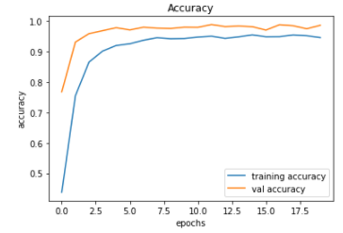
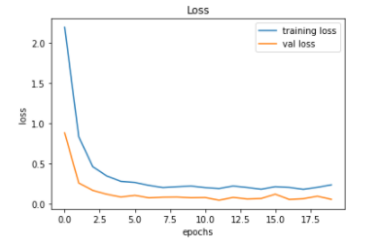
Visualization
Accuracy and loss of training data at epochs=20

Slide 8
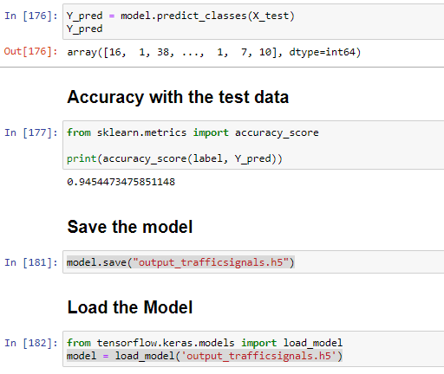
Testing , Evaluating , Saving & loading the sequential(.h5) DL model

Slide 9
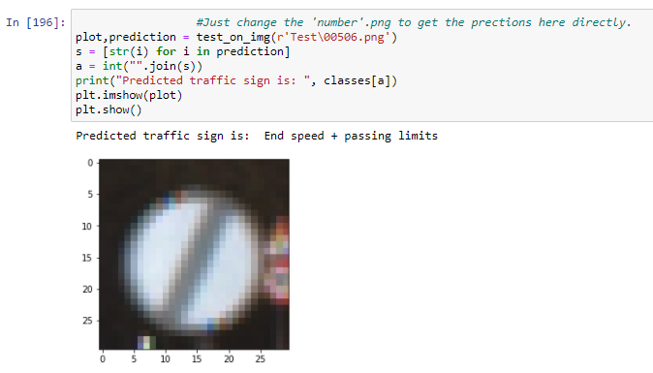
Predicting and visualizing randomly

Slide 10
conclusion
In this Deep Neural Network model we can classify traffic signs present in the image , into different traffic sign categories.
With this model,
We are to read and understand traffic signs which are a very important task for all autonomous vehicles.
Thank you..

